Slide 1
Section 0
Week of January 28

Slide 2
Outline
Introduction
Git
HTML
CSS
Project 0

Slide 3
Introduction: About Me
Elle Buellesbach
Senior in Computer Science, Yale University
elle.buellesbach@yale.edu
Office Hours: Tuesdays 12-3PM EST
Section: Wednesdays 11-12:30PM EST

Slide 4
Introduction: Zoom
Keep microphones muted unless speaking
Questions:
Use the chat box OR
Indicate you’d like to ask a question via chat box and unmute yourself
Breakout rooms
Use for office hours

Slide 5
Introduction: The Course
Project 0 due Monday February 11th
All sections will be recorded and posted within 48 hours
All office hour times and sections posted on the website
CS50 Discourse for discussion
Expectation for section:
Watch the lecture released on the Monday prior
Read the project specification
All section files will be found at https://github.com/ebuellesbach/2019cscie33

Slide 6
Git: Version Control
Features:
Track changes of code
Synchronizes code between different people or projects
Revert to old versions of code
Can test new features without loosing the original
Common commands:
clone
add
commit
push
pull
Keywords: Remote, local, repository

Slide 7
HTML
HyperText Markup Language
Allows for the formatting of text (markup language) for websites
Keywords: tag

Slide 8


HTML Links
<a href=[URL or Filename]> Click Me! </a>
Example file structure:
2019cscie33
section_0
index.html
page2.html
Keywords: directory

Slide 9
Document Object Model
How HTML is organized
This was referenced in the first lecture as DOM and will be important for later weeks to make pages more dynamic
Keywords: child, sibling, parent, element

Slide 10
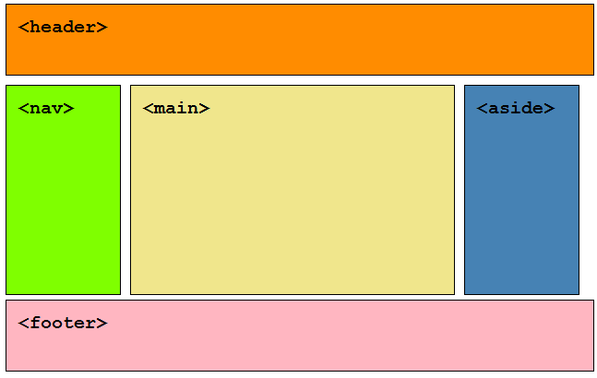

Slide 11
<html>
<head>
<title>Hello, world</title>
</head>
<body>
<h2>Here's my page</h2>
<p>World, hello</p>
<a href="test.html">Link</a>
</body>
</html>
Notes:
Emphasis the link with the attribute href

Slide 12
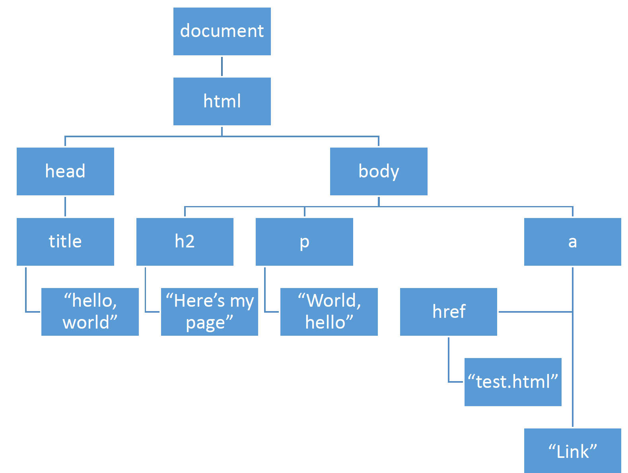
<html>
<head>
<title>Hello, world</title>
</head>
<body>
<h2>Here's my page</h2>
<p>World, hello</p>
<a href="test.html">Link</a>
</body>
</html>

Slide 13
<html>
<head>
<title>Hello, world</title>
</head>
<body>
<h2>Here's my page</h2>
<p>World, hello</p>
<a href="test.html">Link</a>
</body>
</html>

Slide 14
<html>
<head>
<title>Hello, world</title>
</head>
<body>
<h2>Here's my page</h2>
<p>World, hello</p>
<a href="test.html">Link</a>
</body>
</html>

Slide 15
<html>
<head>
<title>Hello, world</title>
</head>
<body>
<h2>Here's my page</h2>
<p>World, hello</p>
<a href="test.html">Link</a>
</body>
</html>

Slide 16
<html>
<head>
<title>Hello, world</title>
</head>
<body>
<h2>Here's my page</h2>
<p>World, hello</p>
<a href="test.html">Link</a>
</body>
</html>

Slide 17
Cascading Style Sheets: CSS
A way to add style to the HTML pages
Generally best practice, have a seperate CSS and HTML file
Link put into the <head> tag
Class selector: .
ID selector: #
<link rel=”stylesheet” href=”styles.css”>
Keywords: selector
Notes:
Where were the other locations for style:
In the HTML tags, in the style tags
Show chrome inspector
Resize image
Change text color
Multiple elements, descendant selector
@media (max-width: 500px) {
}

Slide 18
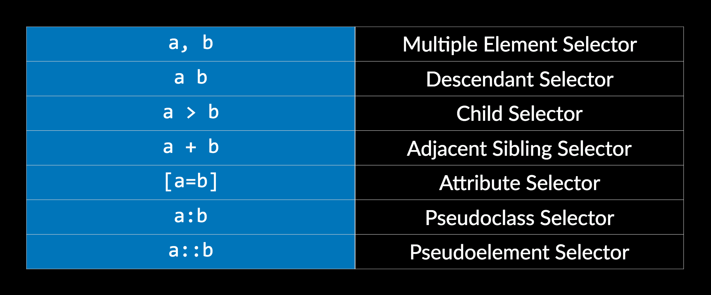
Advanced CSS and HTML
Notes:
Also ask at end: what is bootstrap?

Slide 19
Any remaining questions?

